Slide 1




Self Balancing Monopod: A Reaction Wheel Inverted Pendulum
EEE 318 – Control Systems Laboratory
Jan 2023 Level-3 Term – II Section –C2
Submitted by – Group 05-C2
Ameer Hamja Ibne Jamal
1906177
Fahim Shahriar Anim
1906178
Yeasir Arafat Prodhan
1906191
U Mong Sain Chak
1906195

Slide 2
Outline
Abstract
Introduction
Design
Implementation
Analysis and Evaluation
References
Objective

Slide 3
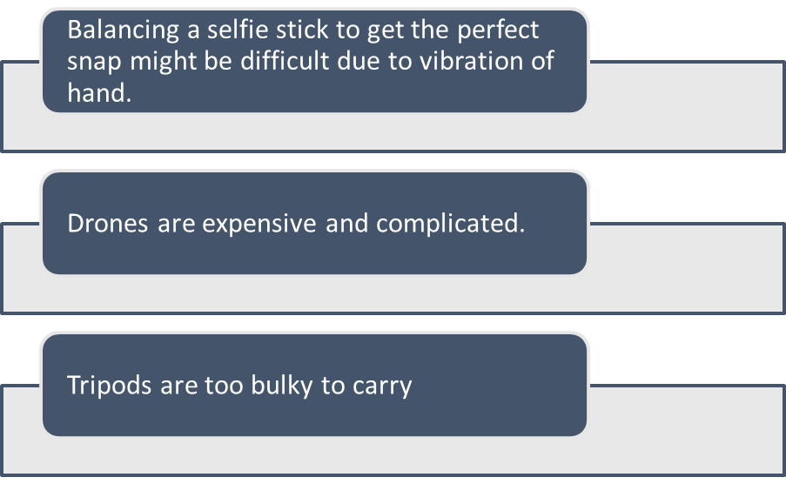
Abstract
Problem Statement: A Scenario
While being on a hiking trip, to snap a group photo, you either need a drone, a tripod, or a selfie stick and certain problems arise:

Slide 4
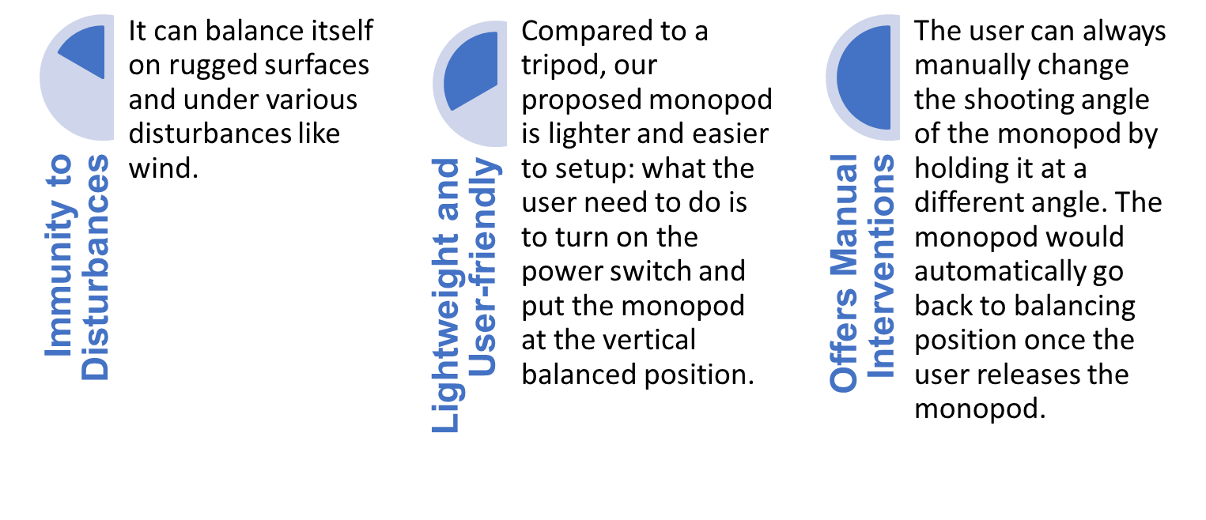
Abstract
Proposed Solution
Therefore, a monopod that can balance itself can be a suitable solution having certain pros mentioned below:
Presented by: 1906XXX

Slide 5
Introduction
About Self Balancing Monopod
The technical term for this is a "reaction wheel inverted pendulum". Basically, the motors at the top of the monopod spin up and spin down, creating a torque on the monopod. That torque is used to bring the monopod back to its most stable position, thereby preventing it from falling.
The gyro and accelerometer uses the current angle and change in angle with respect to time (angular speed) to create torque to the motor using a PID control algorithm
Presented by: 1906XXX

Slide 6
Objective
The basic goal of this project is to build such a user-friendly and most importantly cost-effective self balancing monopod which works on the basis of a reaction wheel inverted pendulum.
Presented by: 1906XXX

Slide 7
Design: Problem Formulation (PO(b))
Identification of Scope
An inverted pendulum system with a reaction wheel is a classic control system problem that is often used in robotics and control theory to study and demonstrate various control techniques.
To identify the scope for a reaction wheel inverted pendulum system, several aspects were considered:
Developing a mathematical model of the system by understanding various physical properties of the pendulum.
Selecting an appropriate control strategy (for example PID control, LQR Control) for achieving the control objectives. In our project PID mechanism is implemented.
Determining the sensors and actuators needed for our system. In this case, sensors to measure the pendulum's angle and angular velocity and actuators to control the reaction wheel's speed were needed.
Noise and external disturbances may affect the system's performance. In this project control system was designed having an aim to handle these disturbances and maintain stability.
To improve the system's performance, the system was continuously tuned and optimized by adjusting control gains, implementing anti-windup mechanisms, or using adaptive control techniques.
Presented by: 1906XXX

Slide 8
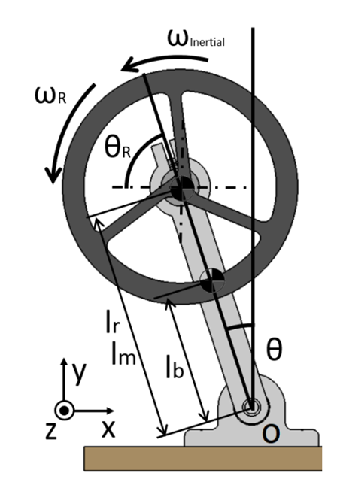
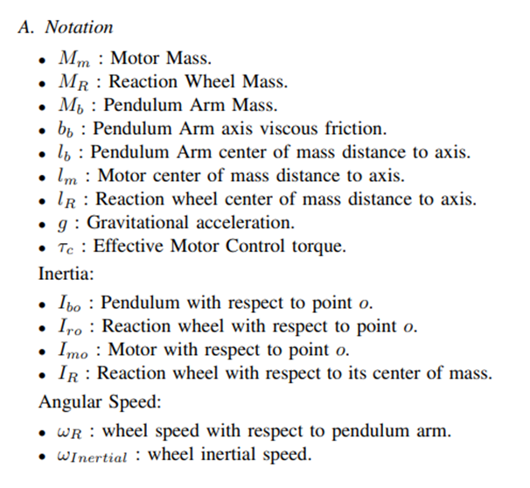
Design: Problem Formulation (PO(b))
Formulation of Problem
Presented by: 1906178

Slide 9
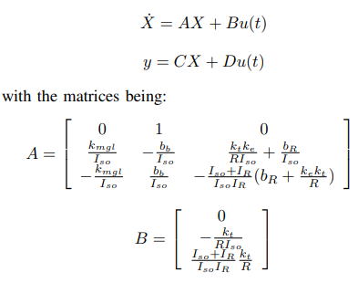
Design: Problem Formulation (PO(b))
Formulation of Problem
It is practically a non-linear system hence has to be linearized.
The State Space can be designed as such
Presented by: 1906178

Slide 10
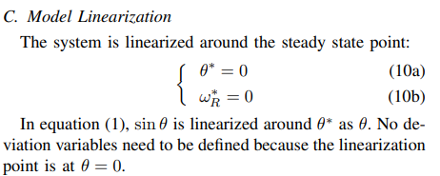
Design: Problem Formulation (PO(b))
Formulation of Problem
Presented by: 1906178

Slide 11
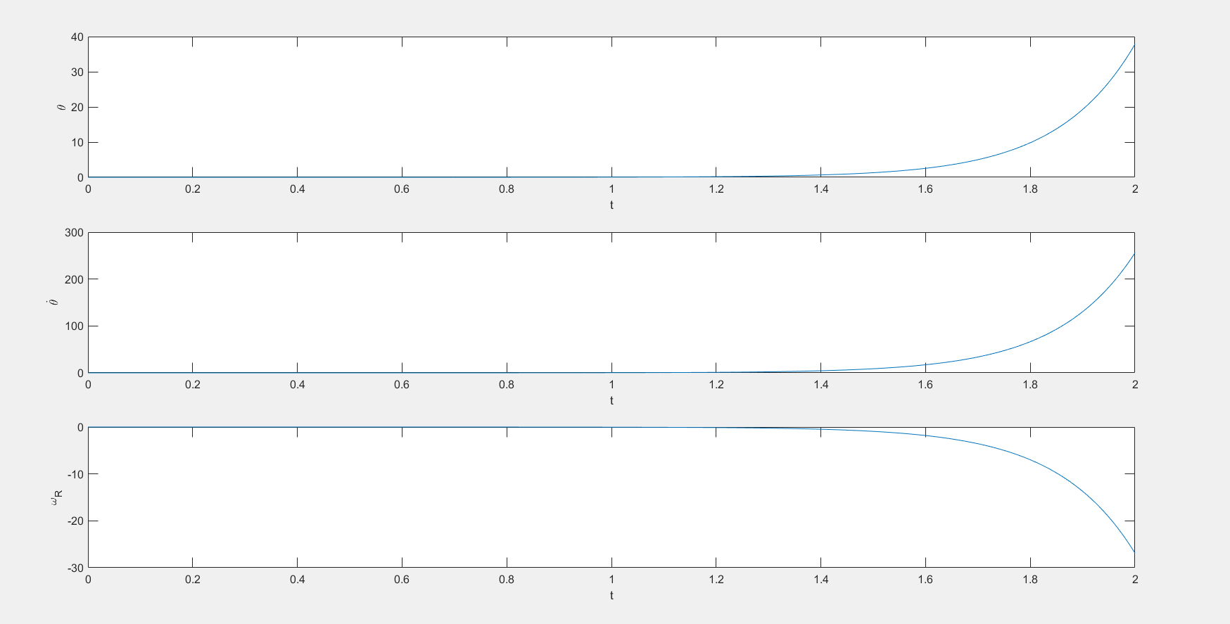
Design: Simulation
A matlab program was simulated using the “TWIDDLE” algorithm for PID tuning.
Open Loop System
Presented by: 1706XXX

Slide 12
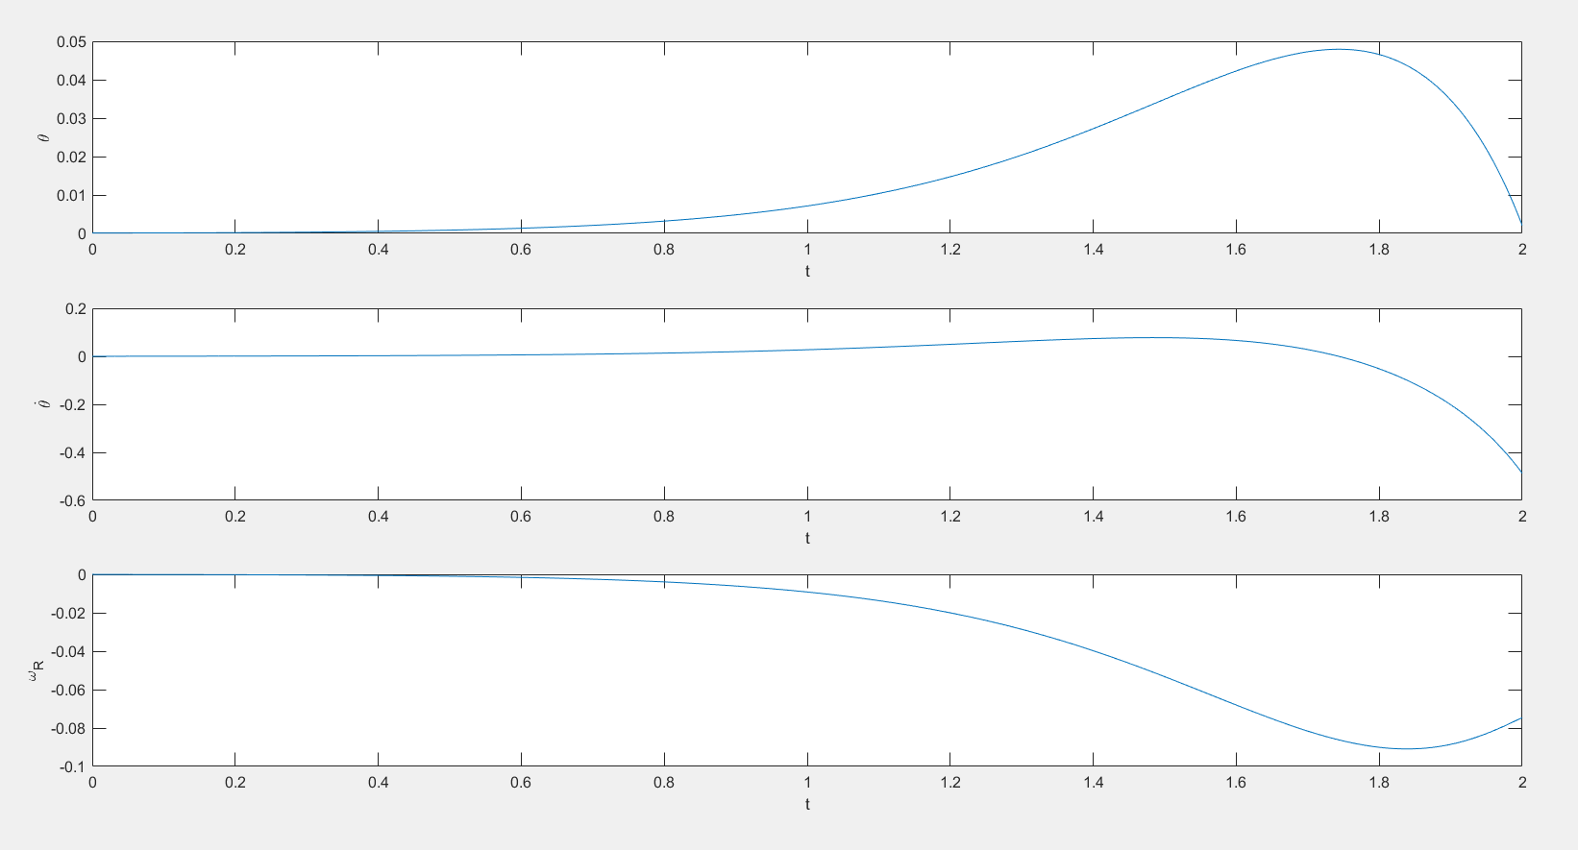
Design: Simulation
Closed Loop System

Slide 13
Design Methods (PO(a))
Components Used:
Name | Quantity
6 Degrees of Freedom IMU Breakout – MPU6050 | 1
Arduino nano | 1
ESC 30A Bidirectional BLDC motor speed controller | 1
1400 rpm/V Brushless DC motor | 1
Rechargeable Battery | 1

Slide 14
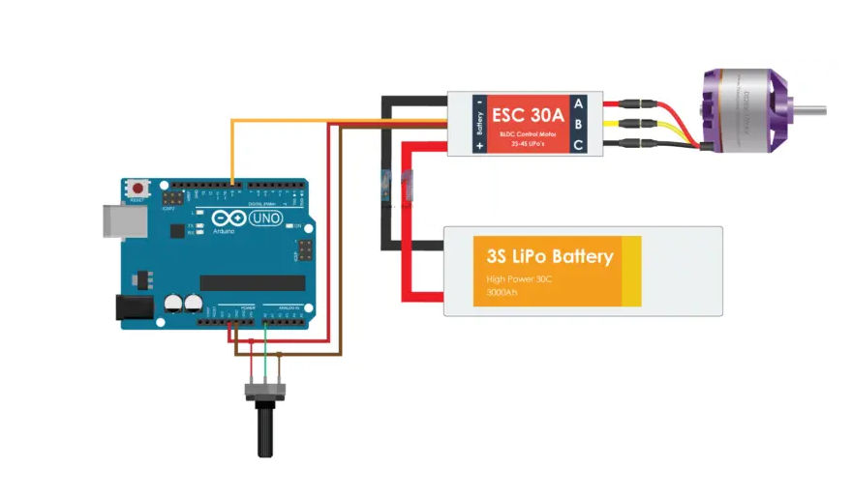
Design: Circuit Diagram
Presented by: 1706XXX

Slide 15
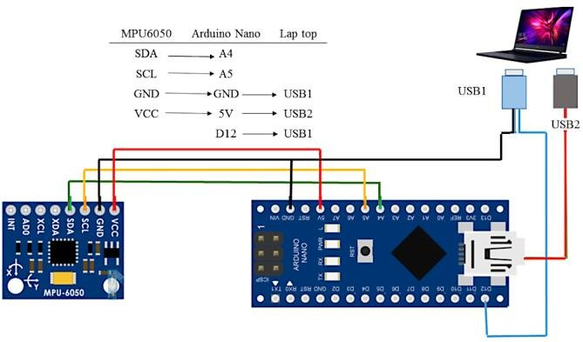
Design: Circuit Diagram
Presented by: 1706XXX

Slide 16
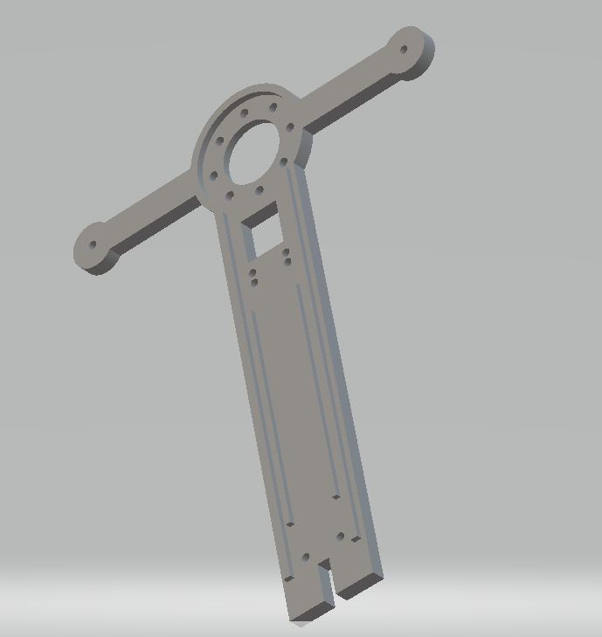
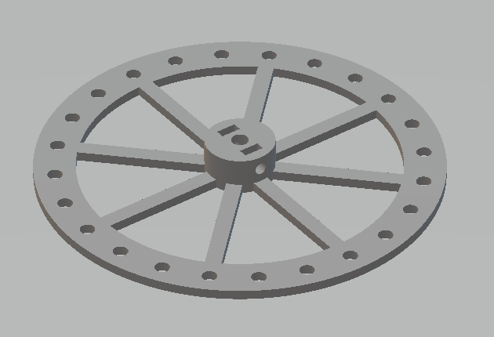
Hardware Design
Presented by: 1706XXX

Slide 17
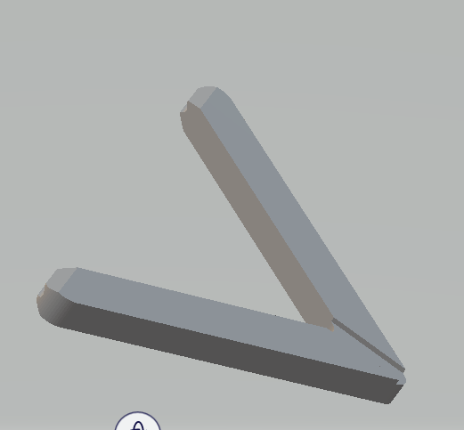
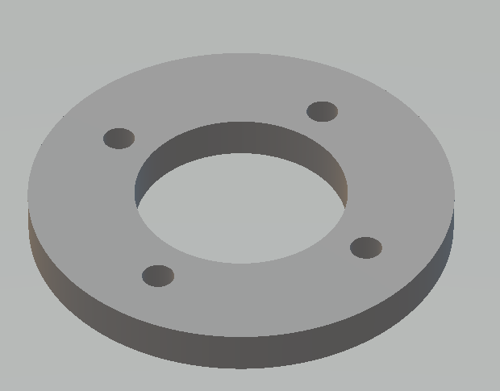
Hardware Design
Presented by: 1706XXX

Slide 18
Implementation:
Position Sensing by IMU
Calibrating the motor
Using the PID parameters to control the PWM which in result creates torque to rotate the motor
Presented by: 1706XXX

Slide 19
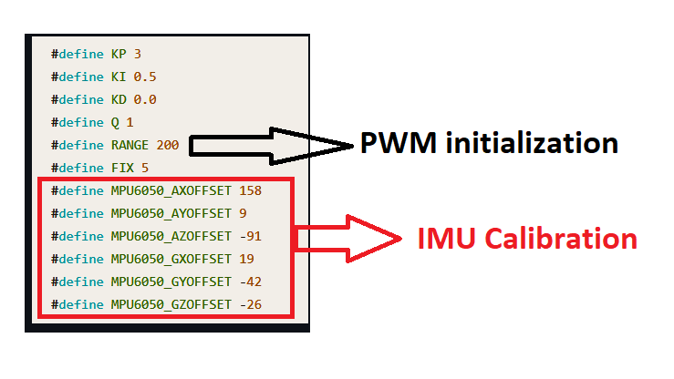
Implementation: Calibrating the IMU
Presented by: 1706XXX

Slide 20
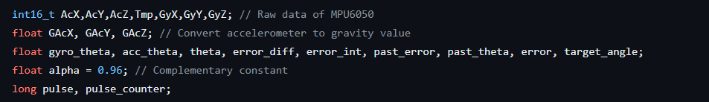
Implementation: Parameters
Presented by: 1706XXX

Slide 21
Implementation: Noise Reduction
Accelerometer – The accelerometer shows sudden drop in readings due to high frequency noise. So sudden jerk is seen.
Gyro – Low frequency noise.
Solution- Complementary filter. Sensor fusion technique.
Presented by: 1706XXX

Slide 22
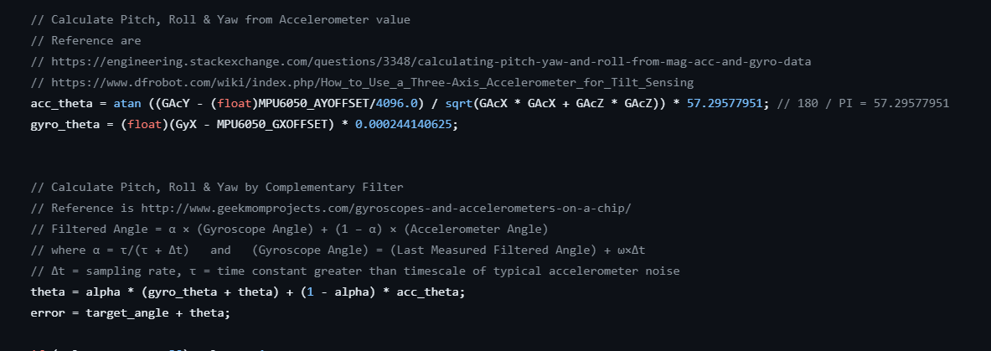
Implementation: Sensor Fusion
Presented by: 1706XXX

Slide 23
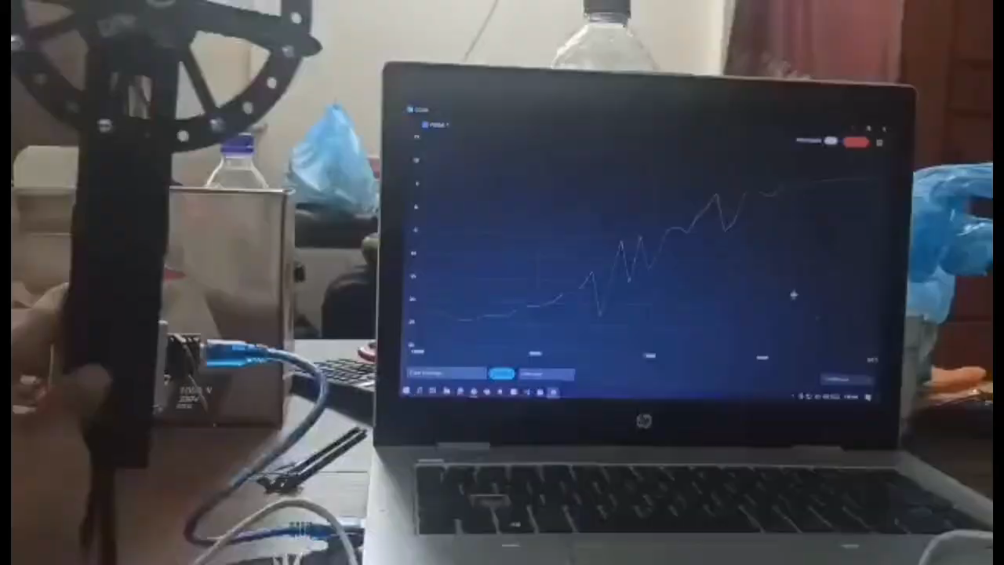
Implementation: Demonstration without Complementary Filter
Presented by: 1706XXX

Slide 24
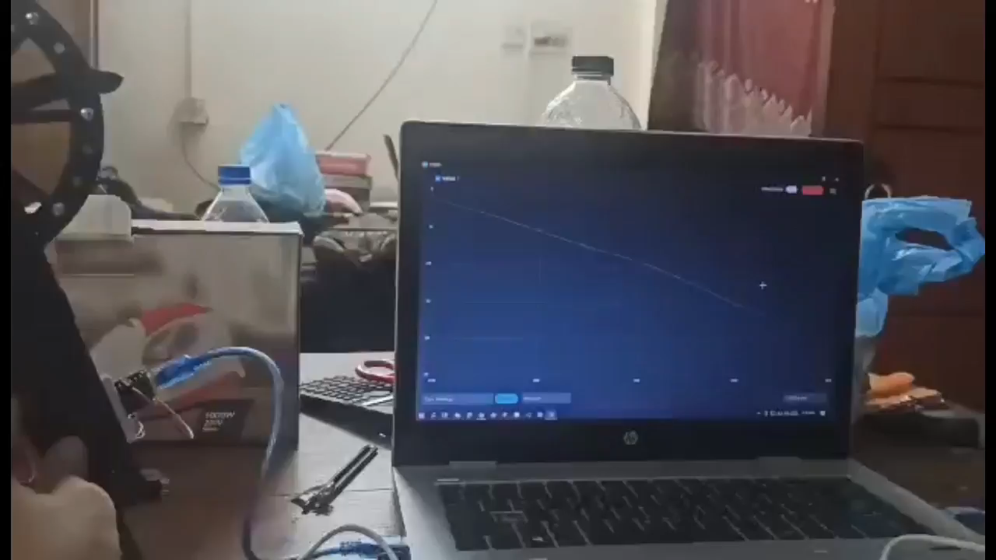
Implementation: Demonstration with Filter
Presented by: 1706XXX

Slide 25
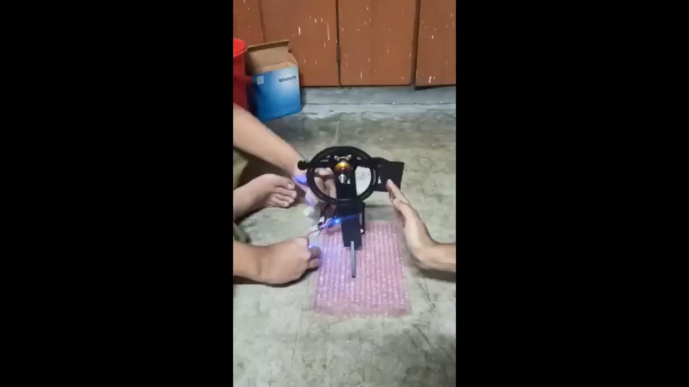
Implementation:
Presented by: 1706XXX

Slide 26
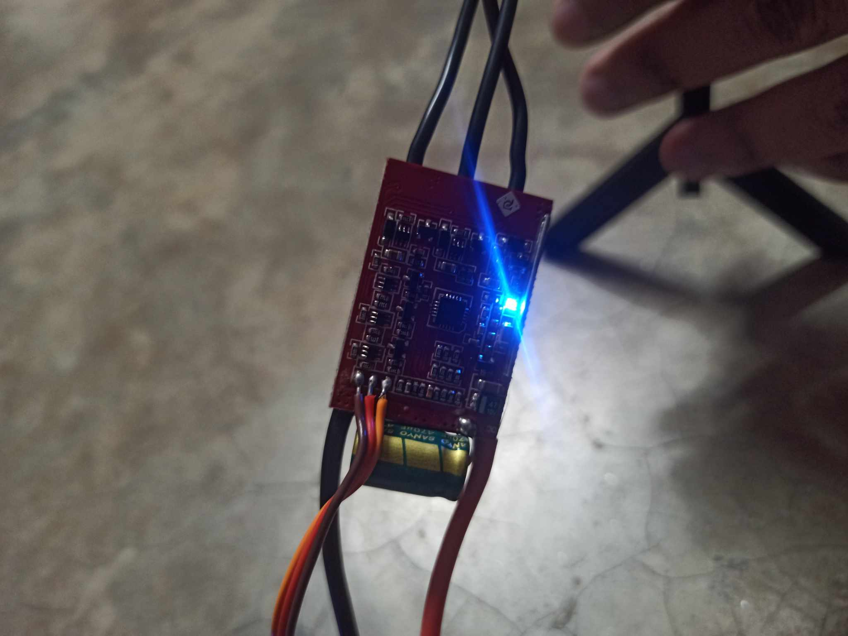
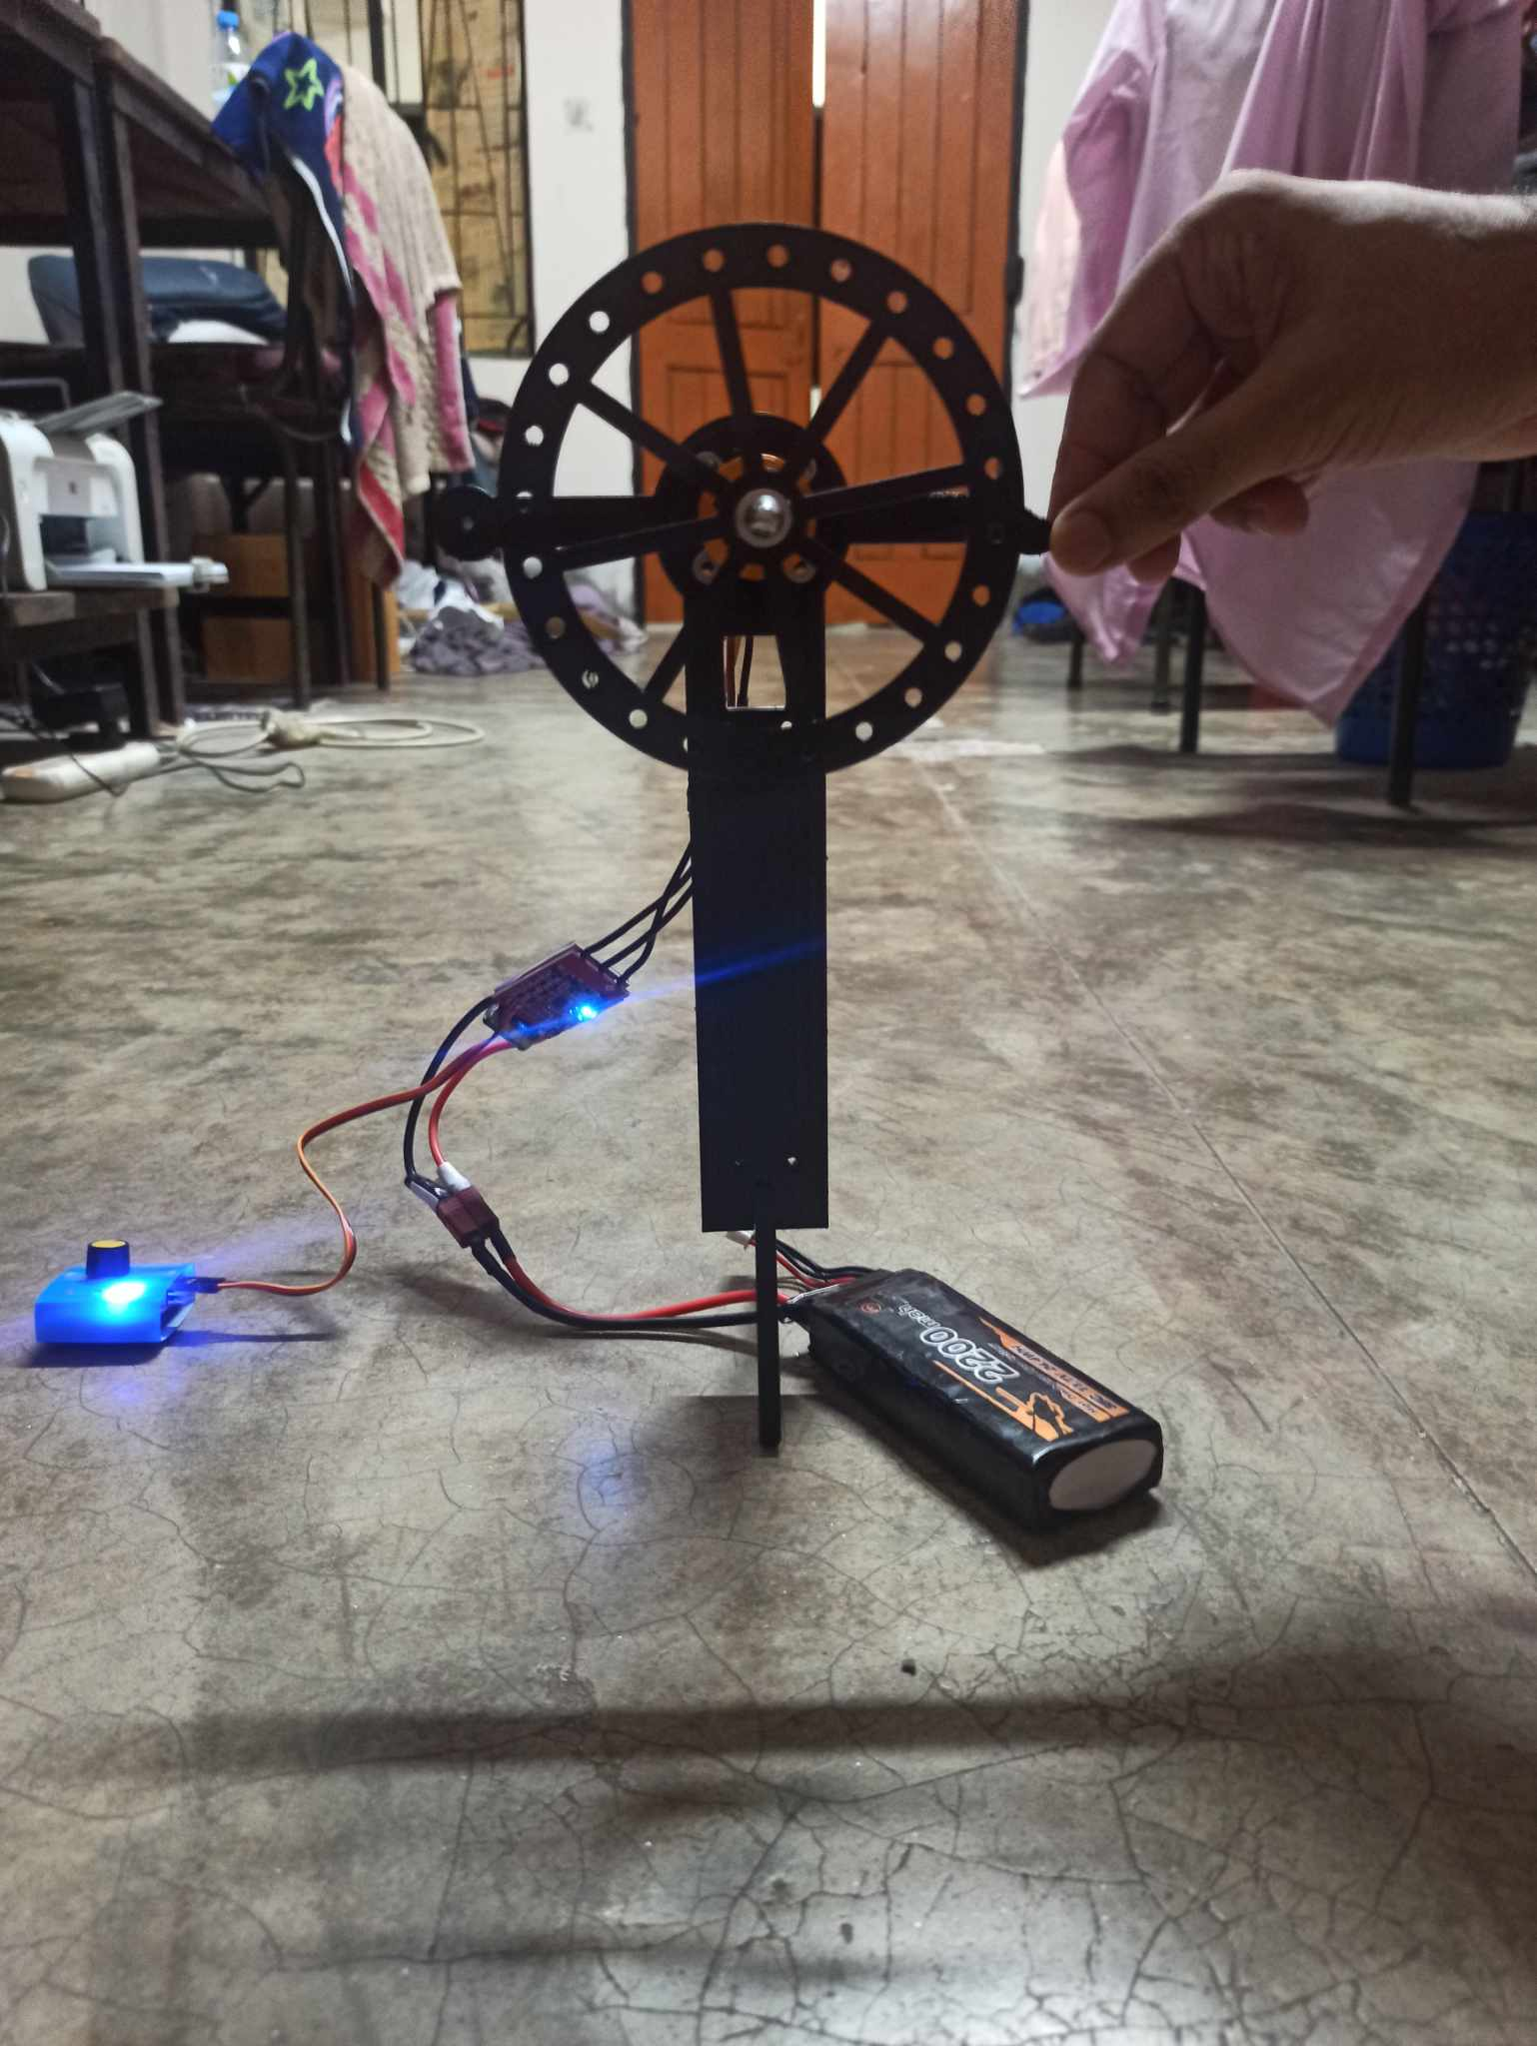
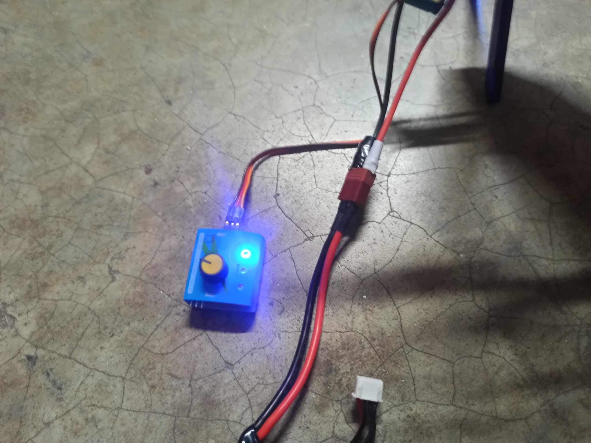
Implementation: Photo Gallary
Presented by: 1706XXX

Slide 27
Design Analysis and Evaluation
Novelty
Investigations (PO(d))
Limitations of Tools (PO(e))
Impact Assessment (PO(f))
Sustainability and Envaronmental Impact Evaluation (PO(g))
Presented by: 1706XXX

Slide 28
Novelty
Low Power Consumption
Budget Friendly
Presented by: 1706XXX

Slide 29
Investigation (PO(d))
Obstacles:
Due to unavailability of appropriate motor, we could not incorporate instant braking feature. Hence due to inertia effect, the main axis could not balance itself.
Additionally, the motor we used was a BLDC motor and a tachometer to measure angular speed could not be mounted.
Due to geometrical complexity we could not simulate the matlab file to find appropriate tuned PID parameters. We used trial and error method to optimize Kp, Ki and Kd values.
The surface needs to have enough friction to handle the rotational speed of motor which is also a reason for additional disturbances.
Presented by: 1706XXX

Slide 30
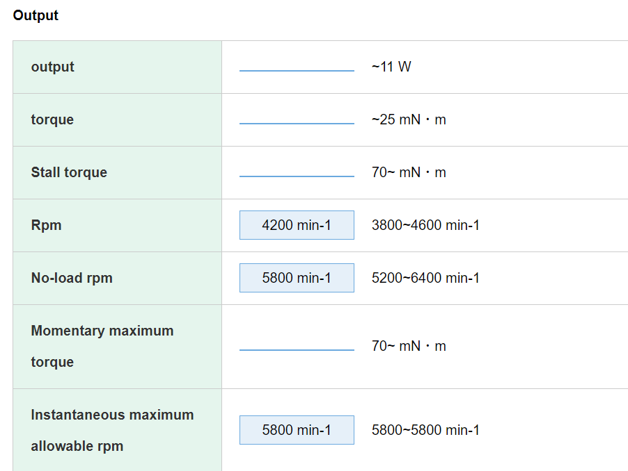
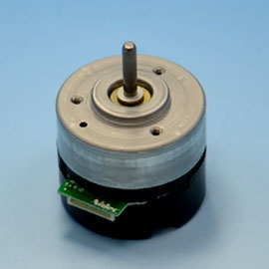
Limitations of Tools (PO(e))
Desired Motor: Nidec 24H
Desired Characteristics:
Instantaneous Brake feature
Presented by: 1706XXX

Slide 31
Impact Assessment: Society (PO(f))
Considerations to public health and safety
This project was implemented Lithium Ion Battery which has to be handled carefully while using, specially during charging. Reckless use and carelessness may result in damage, although not very significant.
Considerations to environment
Considerations to cultural and societal needs
Lithium-ion (Li-ion) batteries and devices containing these batteries should not go in household garbage or recycling bins. They can cause fires during transport or at landfills and recyclers. Instead, Li-ion batteries should be taken to separate recycling or household hazardous waste collection points
Our Project focuses on enhancing personal experience in photography. Hence it has a significant impact on cultural and social occasions.
Presented by: 1706XXX

Slide 32
Sustainability Evaluation (PO(g))
Energy Efficiency
The prototype consumes low electrical power and the bidirectional motor speed controller efficiency is higher than existing unidirectional speed controller
Power Source:
End-of-Life Management:
Lithium-ion (Li-ion) batteries and devices containing these batteries should not go in household garbage or recycling bins. They can cause fires during transport or at landfills and recyclers. Instead, Li-ion batteries should be taken to separate recycling or household hazardous waste collection points
Although the prototype uses Lipo battery, we can use renewable energy sources (i,e, solar cells) to generate electrical power and associate with it.
Presented by: 1706XXX

Slide 33
Individual Contribution of Each Member
ID | Task
1906177 | Calibration of IMU and Hardware Assembly
1906178 | Modelling the characteristics curve in MATLAB and Hardware assembly
1906191 | Modelling the CAD files and Hardware Assembly
1906195 | Calibration of Motor and Trial-Error check
Presented by: 1706XXX

Slide 34
Communication to External Stakeholders (PO(j))
GitHub Link
GitHub - sifat53/Reaction-Wheel-Inverted-Pendulum

Slide 35
Project Management and Cost Analysis (PO(k))
Bill of Materials
Components | No of Units | Cost Per Unit | Total Cost
Arduino Nano R3 | 1 | 850 | 850
A2212 Brushless Motor 1400kV | 1 | 850 | 850
Bidirectional Speed Controller | 1 | 1500 | 1500
IMU 6 D.O.F | 1 | 200 | 200
Lithium Polymer Battery 2200 MAH | 1 | 2500 | 2500
Breadboard, Jumpers and Extras |  | 200 | 200
 |  | Subtotal | 6100

Slide 36
Project Management and Cost Analysis (PO(k))
Per Unit Cost of Prototype :
Cost Type | Amount
Raw materials | 6100
Connection, Soldering and other costs | 200
Labour | Depends on No of Units Produced

Slide 37
References
GitHub - Tomtom93/Reaction-Wheel-Inverted-Pendulum: Two-Axis Reaction Wheel Inverted Pendulum
GitHub - remrc/One-Axis-Self-Balancing-Stick-DC

